Slide 1
Deli Dudes

Slide 2
Description
We will be analyzing Daily Fantasy Sports (DFS), and specifically baseball DFS to try and understand how the big companies (DraftKings, FanDuel, and Yahoo Sports) value individual player performance
We will try and potentially discover any inefficiencies in their pricings

Slide 3
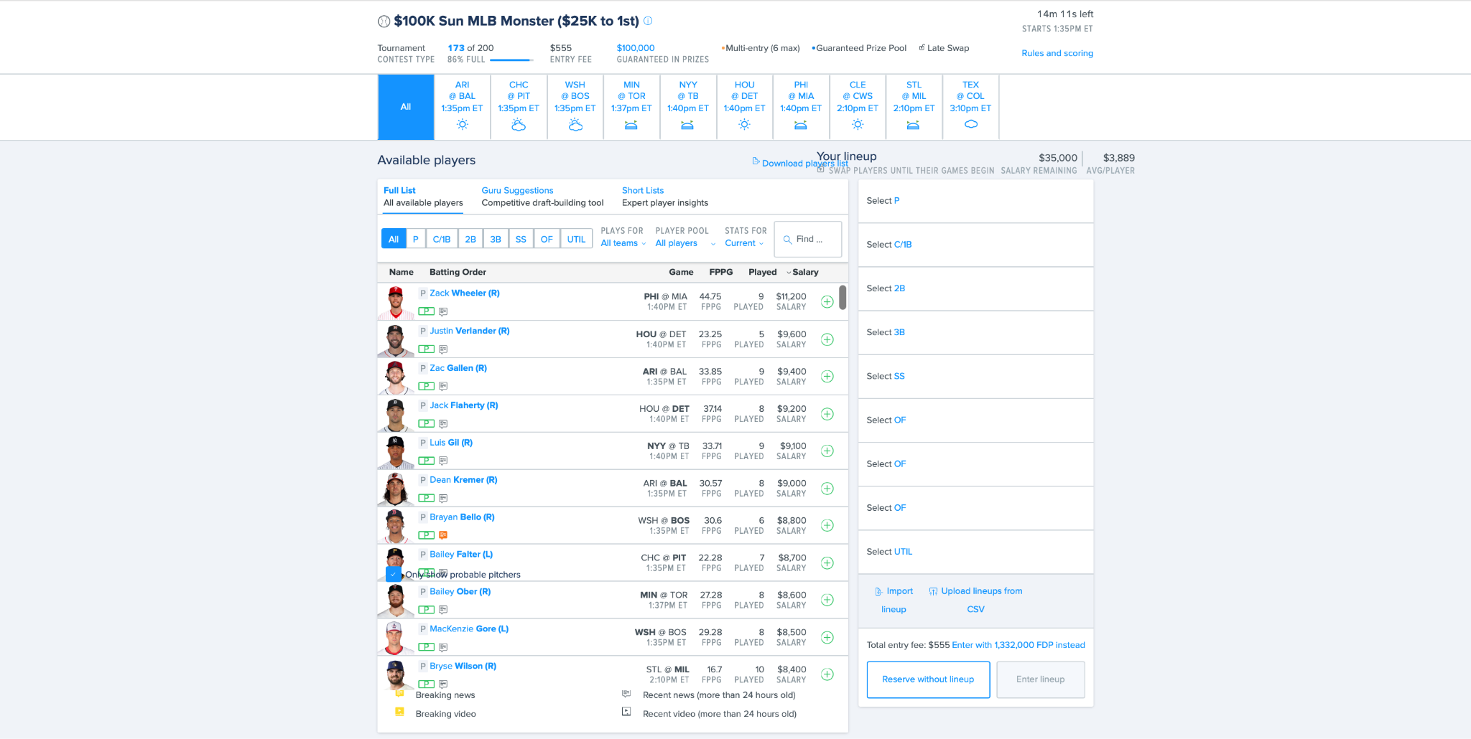
Background: Daily Fantasy Sports (DFS)

Slide 4

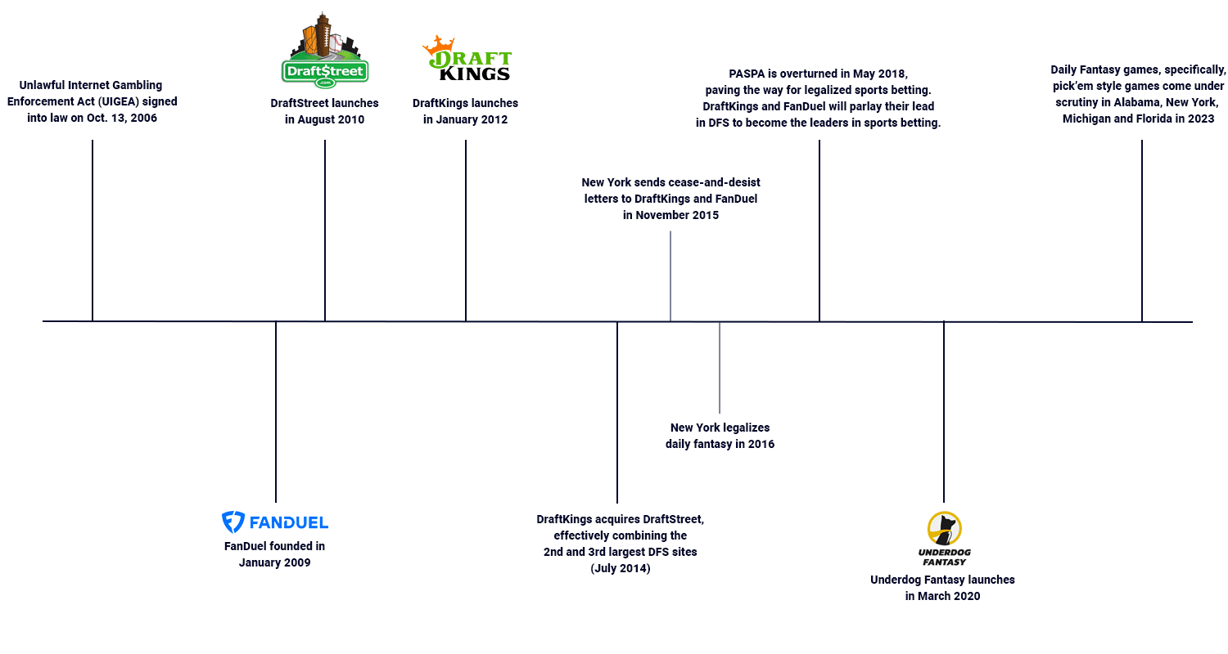


Background: DFS

Slide 5
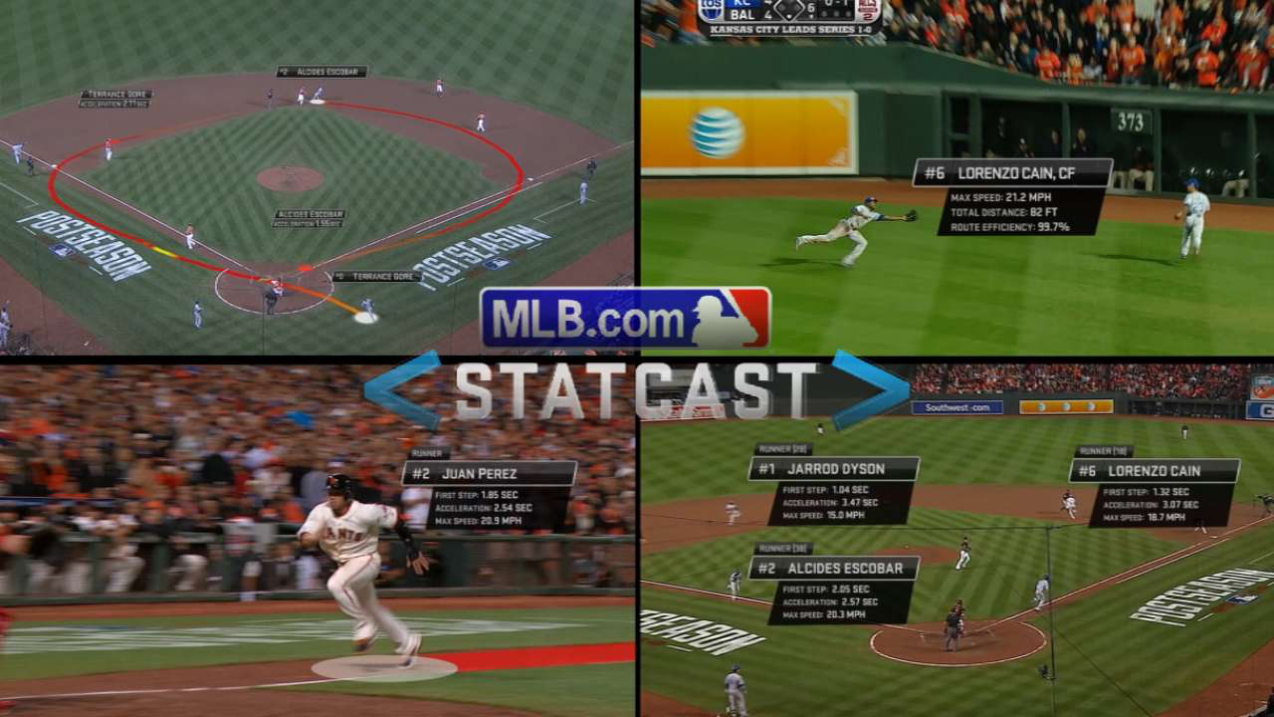
Background: Data in Baseball

Slide 6
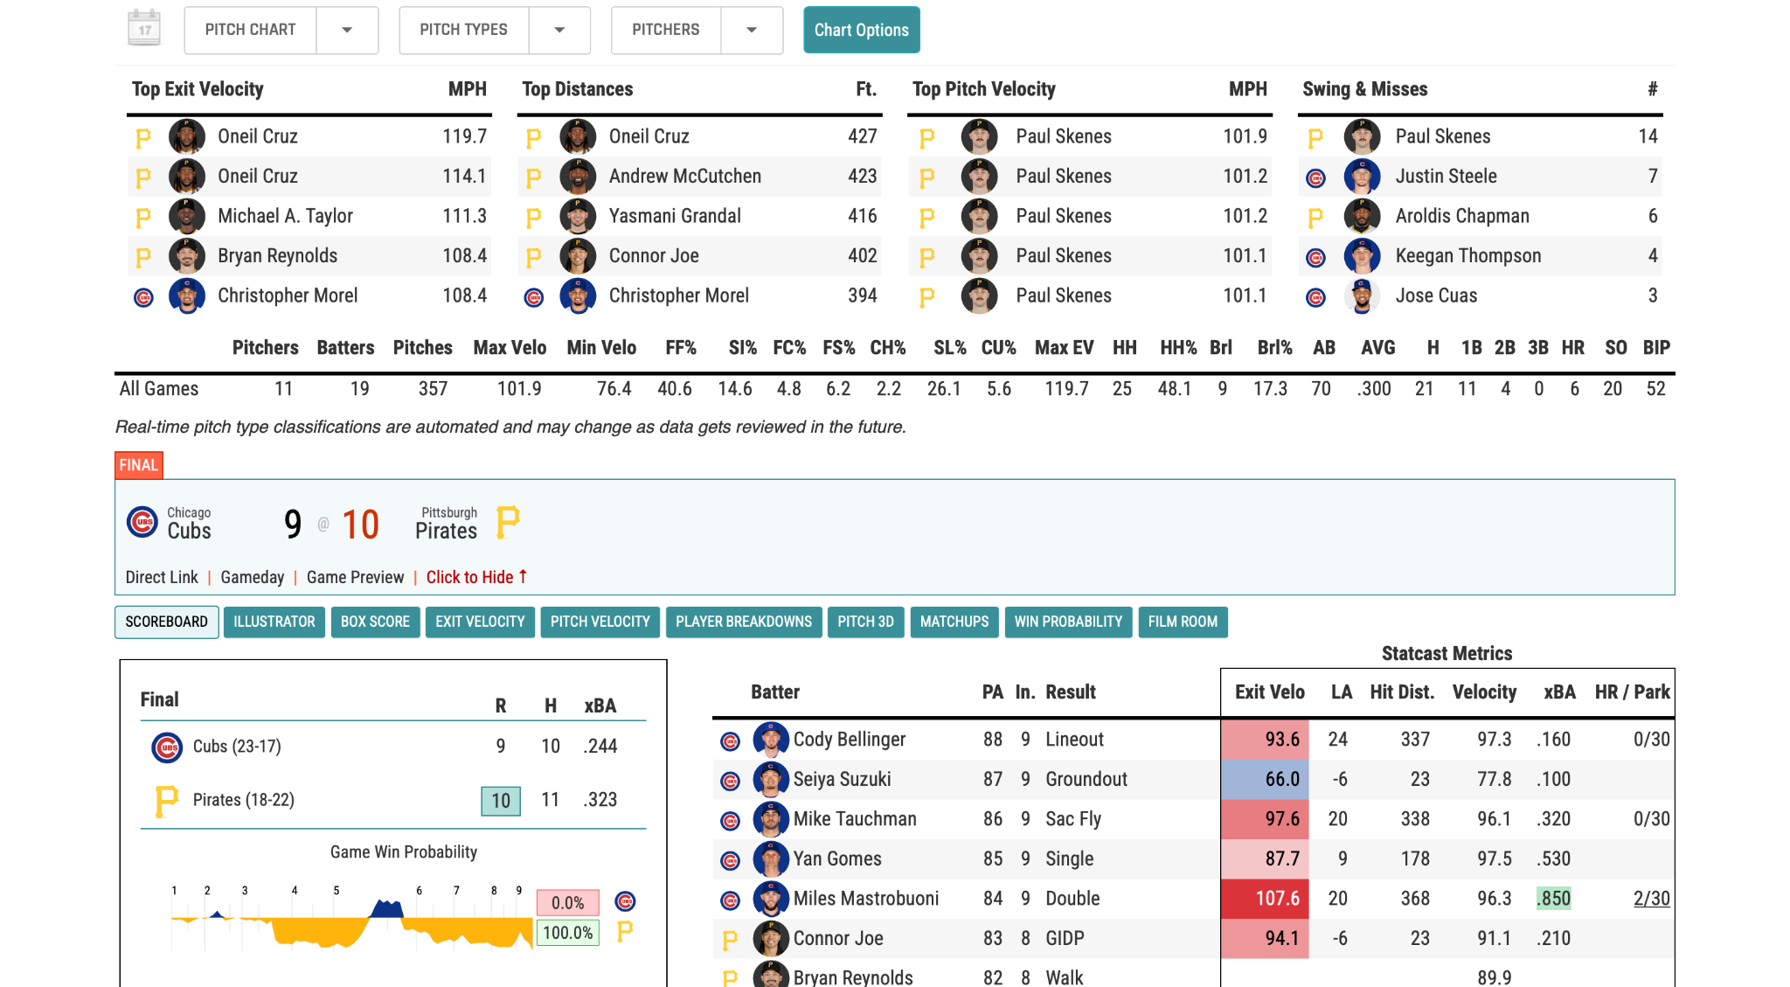

Slide 7
Background: Similar Work
“Investigating Daily Fantasy Baseball: An Approach to Automated Lineup Generation”
Ryan Smith Masters Thesis, Cal Poly
“Picking winners using integer programming”
D. S. Hunter, J. P. Vielma, and T. Zaman.
“Moneyballer: an integer optimization framework for fantasy cricket league selection and substitution”
D. Das.

Slide 8
Data!

Slide 9
Data Sources
rotoguru.net
baseballsavant.com

Slide 10
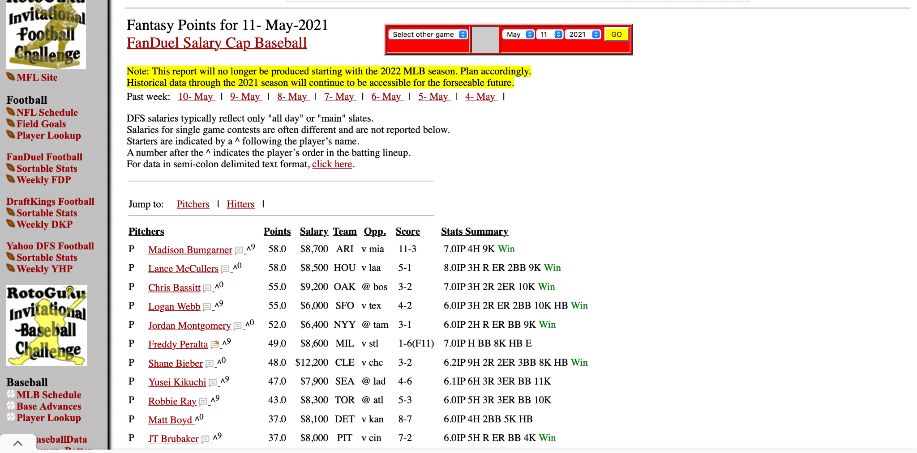

Slide 11
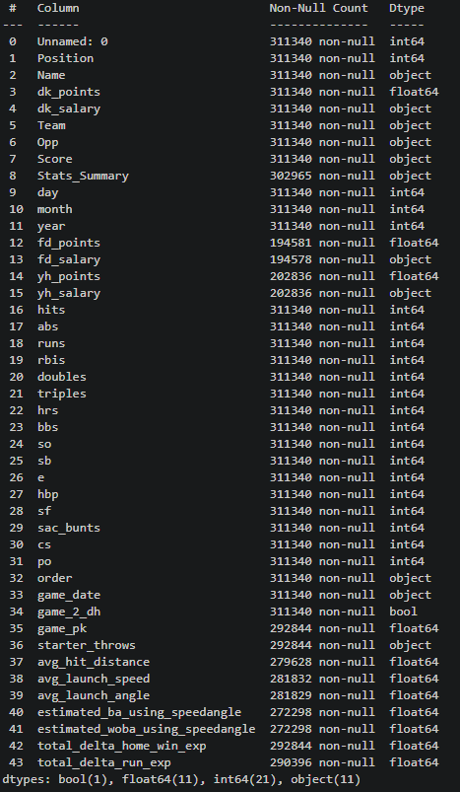
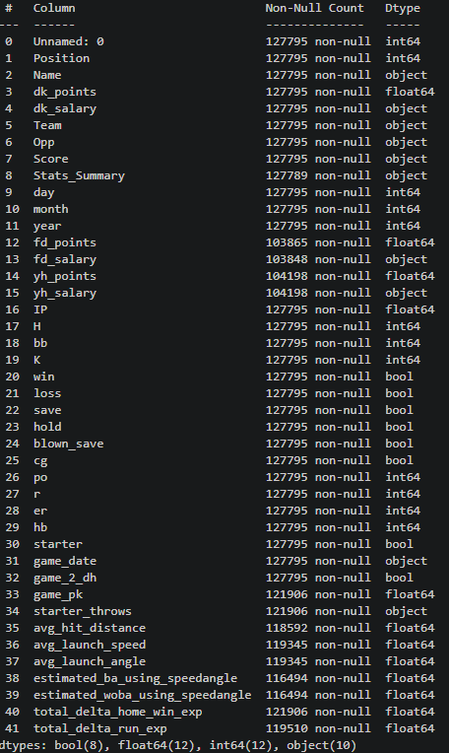
EDA
~ 311k rows for hitter data and ~128k rows for pitcher data,
Hitter info
Pitcher info

Slide 12
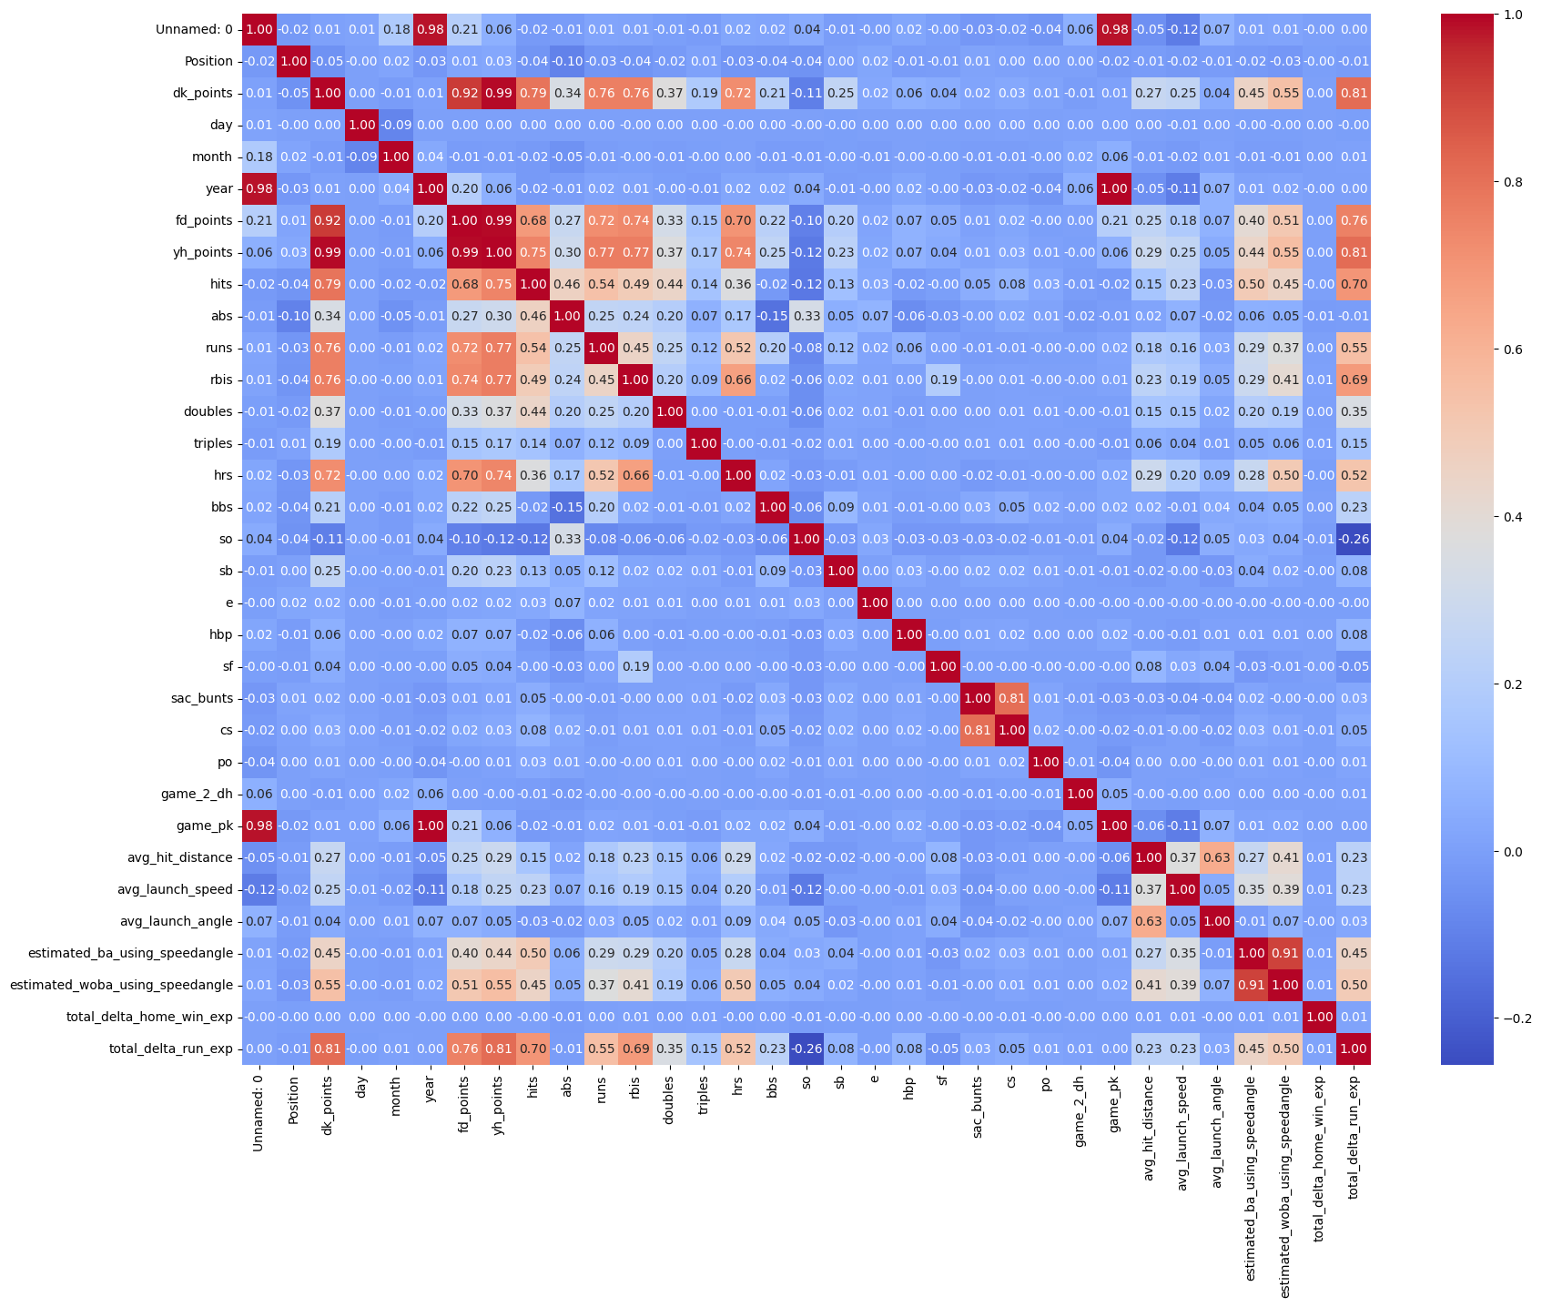
Hitter correlation map

Slide 13
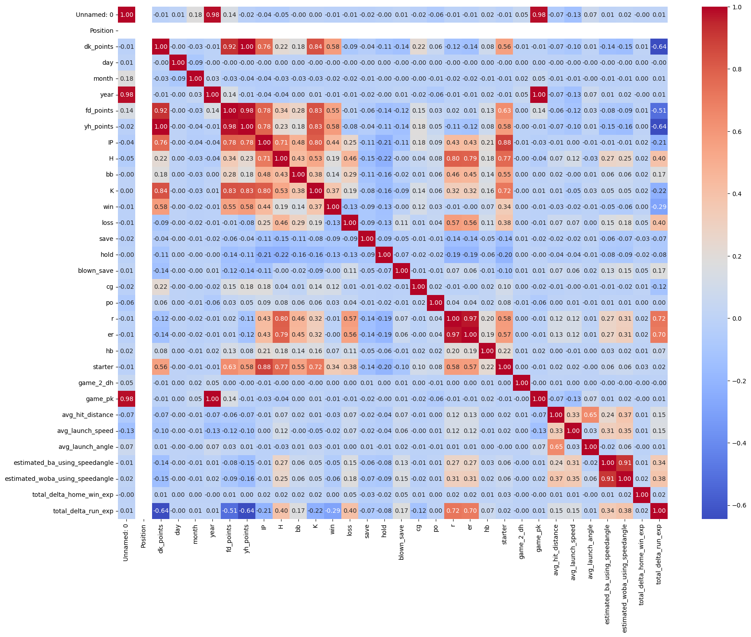
Pitcher correlation map

Slide 14
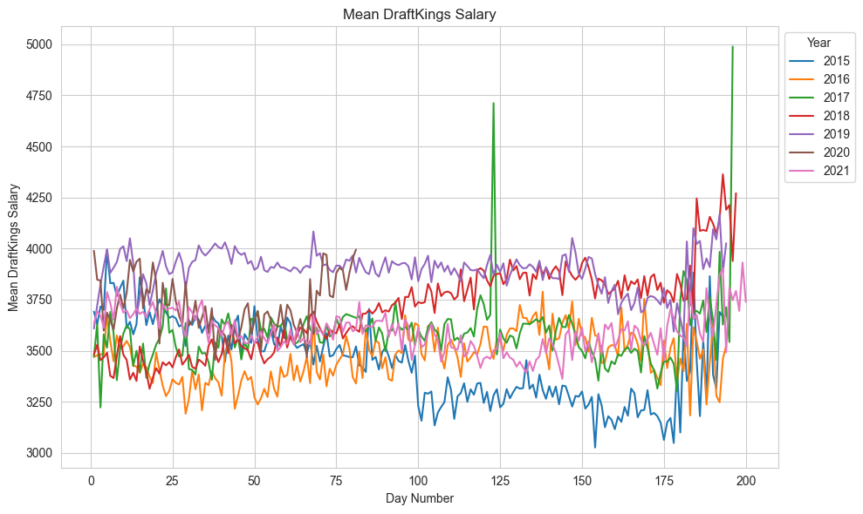
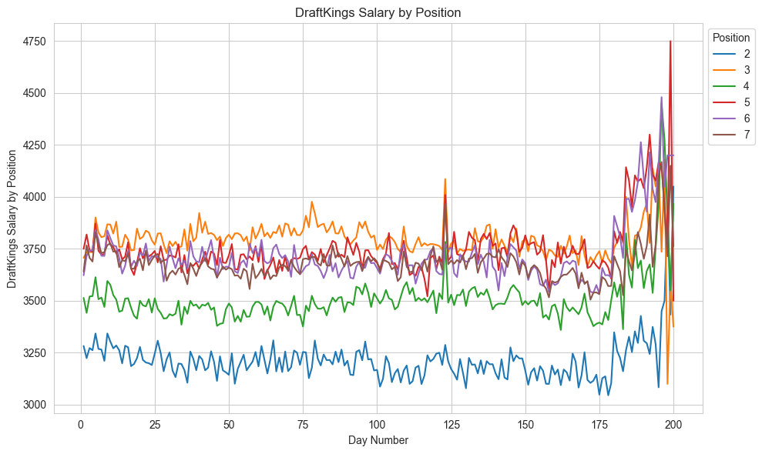
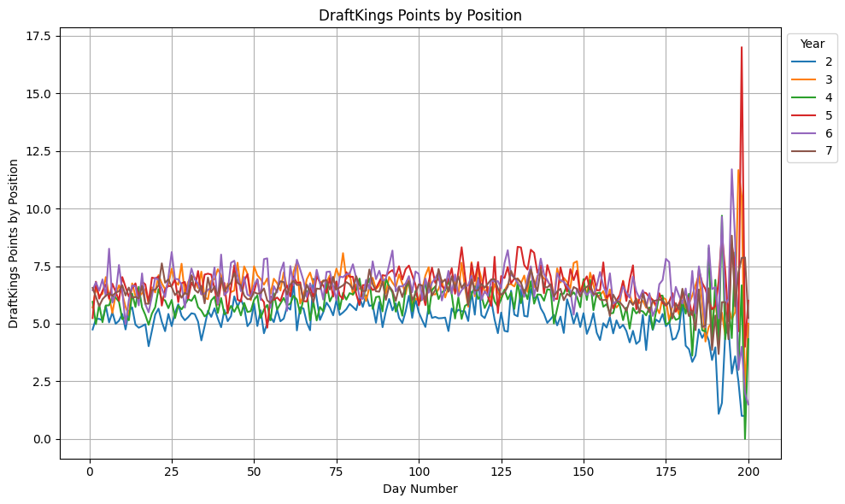
Hitter DraftKings Time Series Visualizations

Slide 15
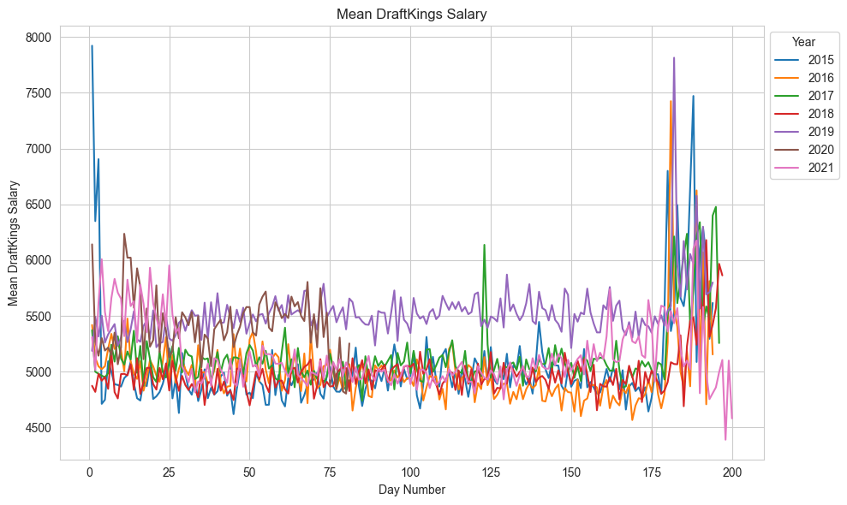
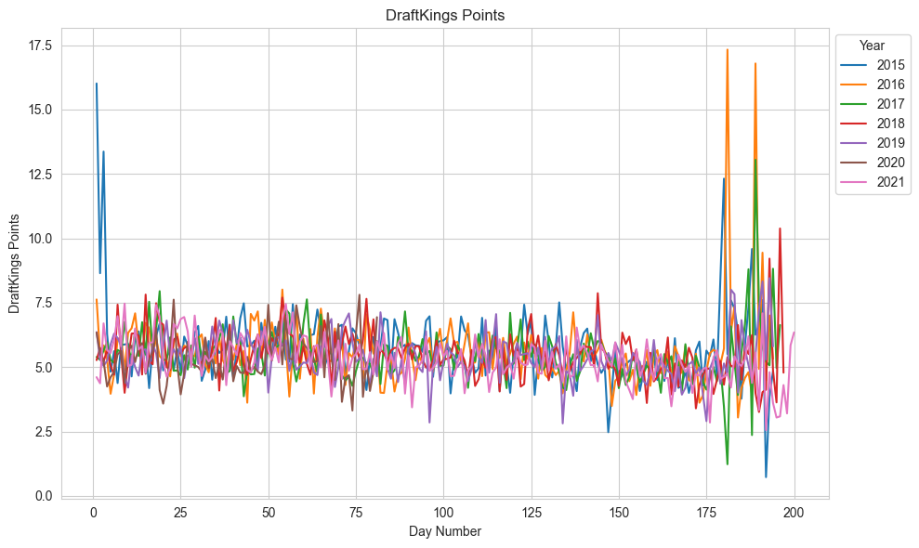
Pitcher DraftKings Stats By Year

Slide 16
Models!

Slide 17
Predicting DraftKings Points: Hitters

Slide 18
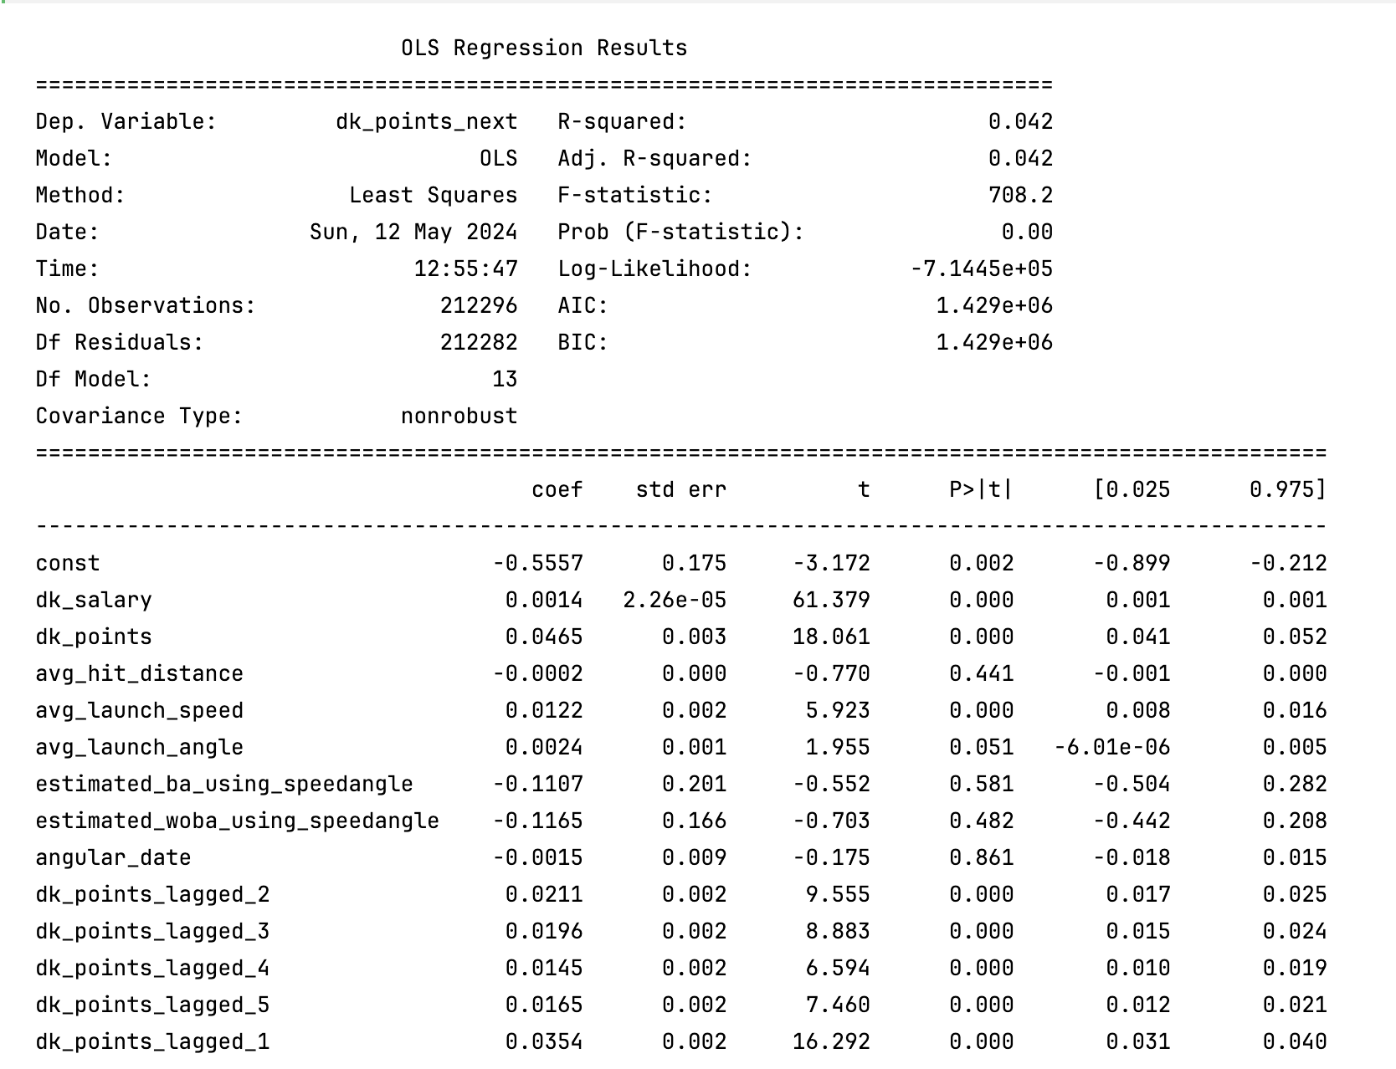
Linear Models: Hitters

Slide 19
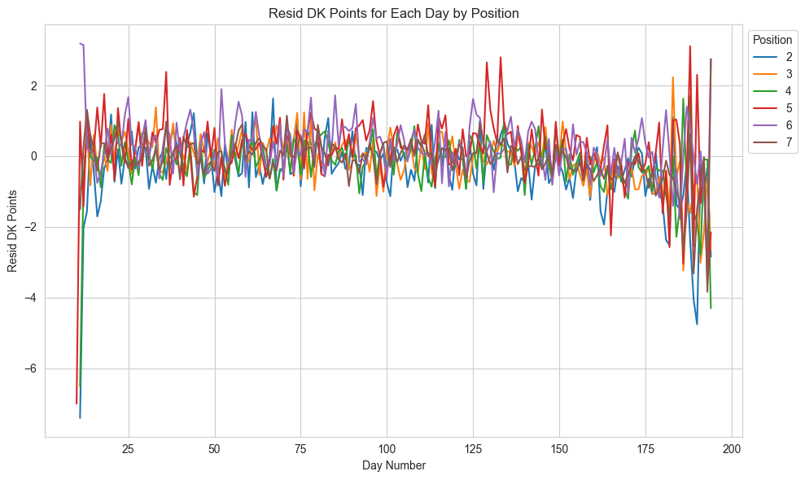
Linear Models: Hitters
Test RMSE: 7.304

Slide 20
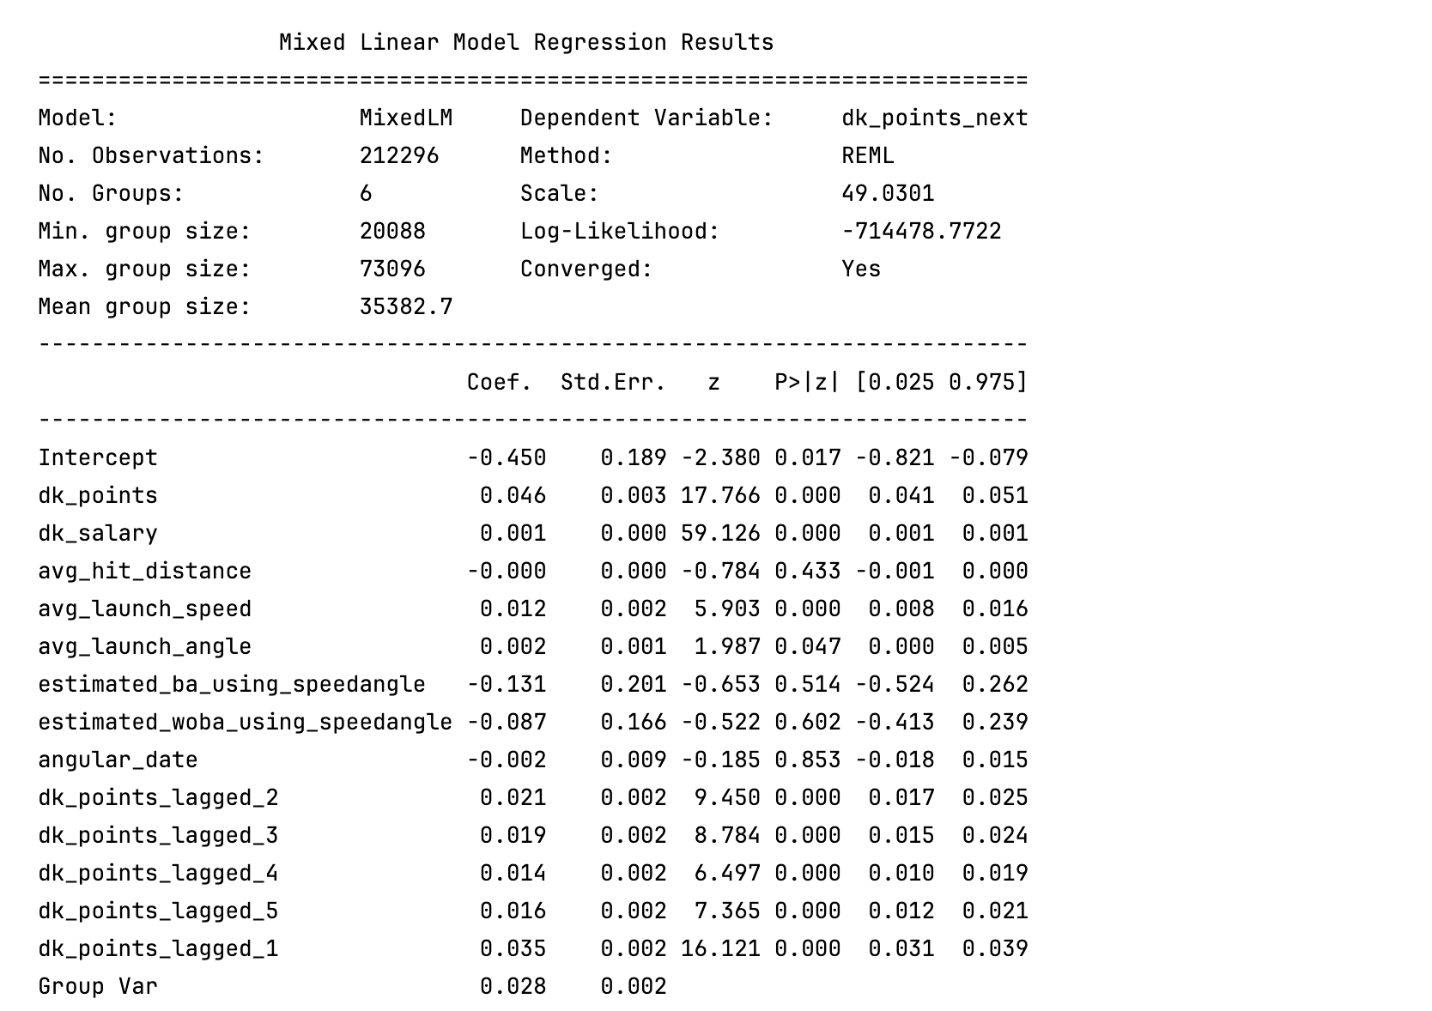
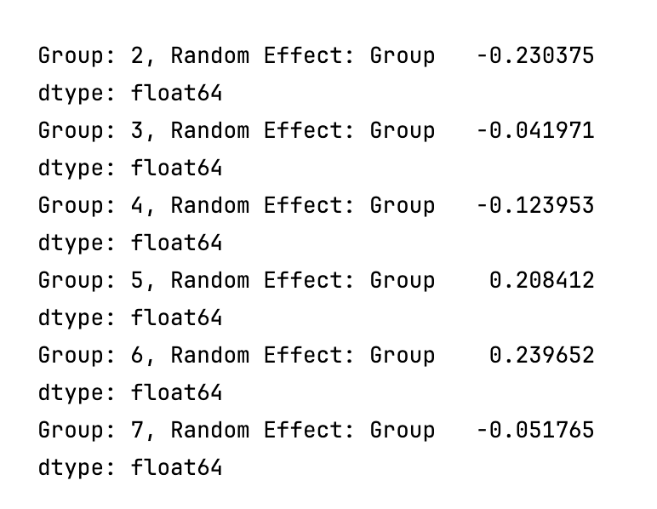
Mixed Effects Models: Hitters

Slide 21
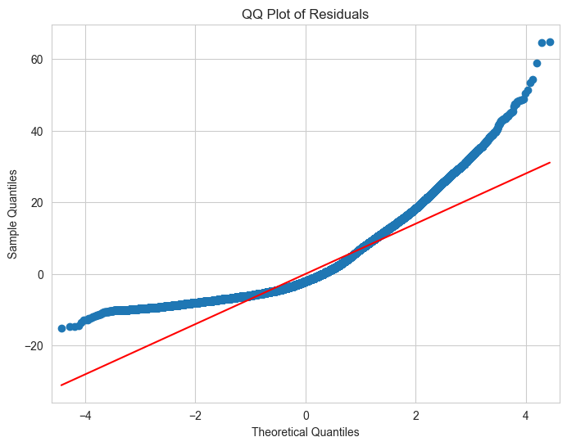
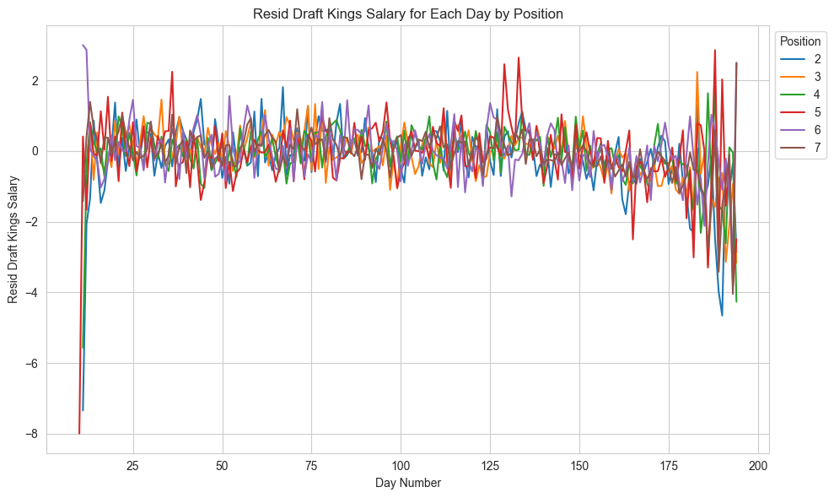
Mixed Effects Models: Hitters
Test RMSE: 7.324

Slide 22
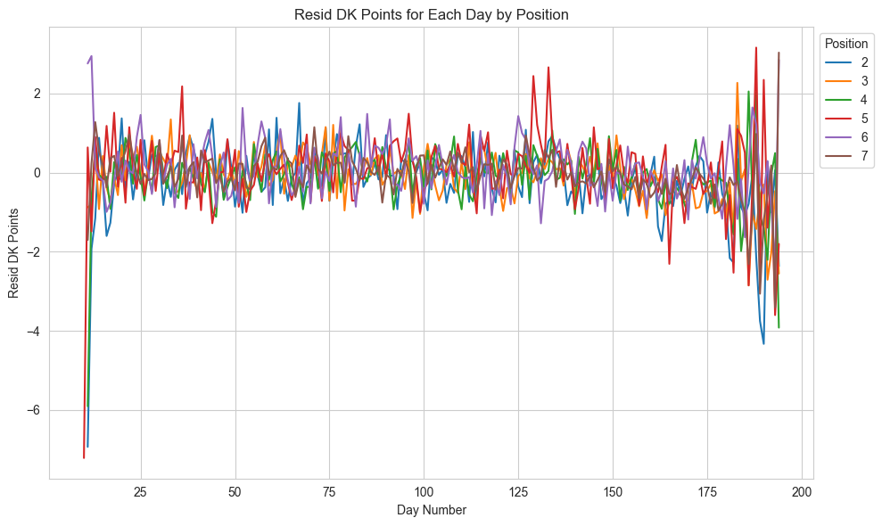
XGBoost: Hitters
Test RMSE: 7.317

Slide 23
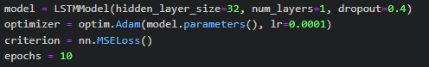
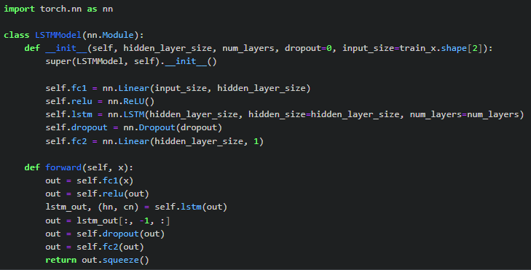
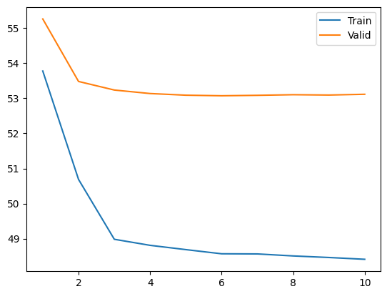
LSTM
RMSE of 6.9 on the test data
Used a sequence length of 5

Slide 24
Predicting DraftKings Points: Pitchers

Slide 25
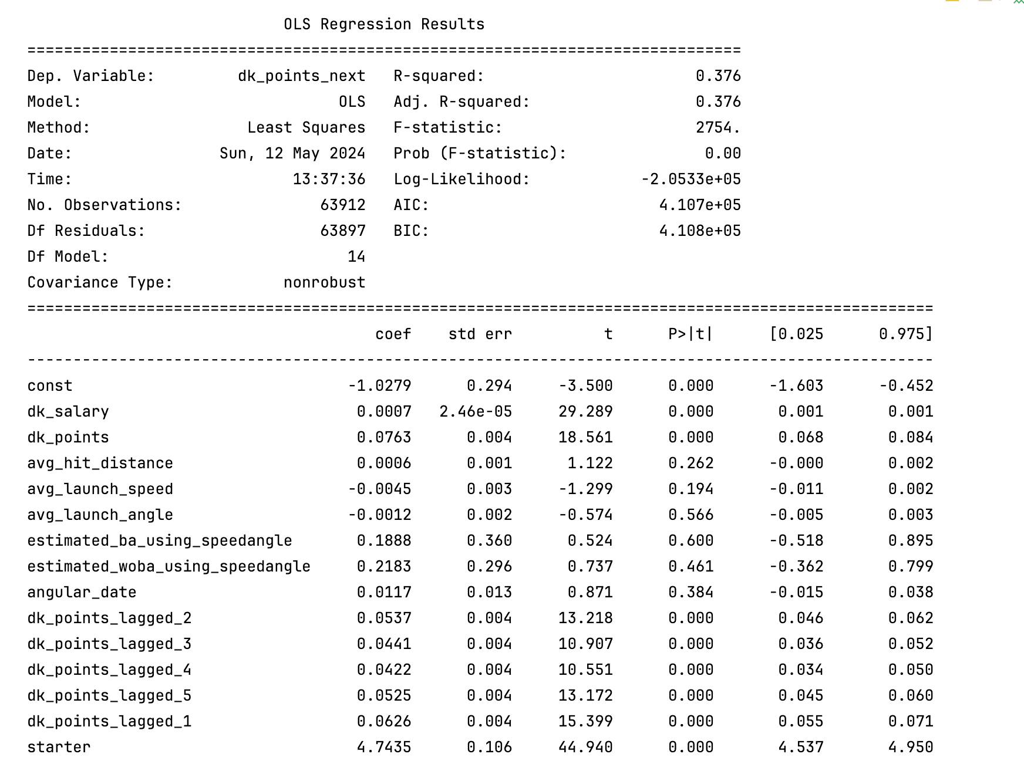
Linear Models: Pitchers

Slide 26
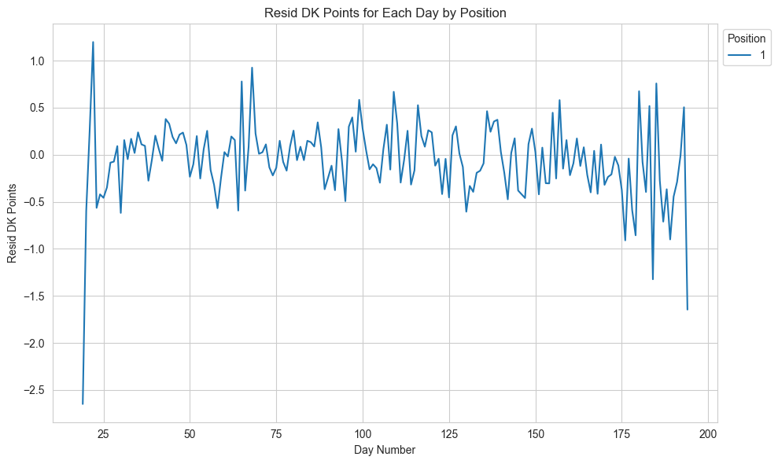
Linear Models: Pitchers
RMSE: 4.213

Slide 27
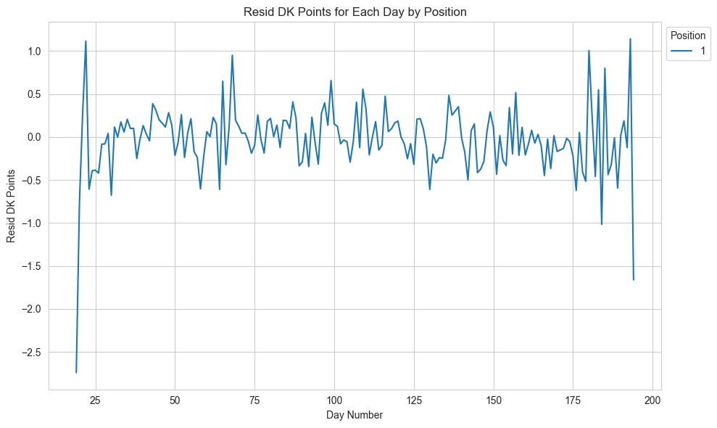
XGBoost: Pitchers
RMSE: 4.178

Slide 28
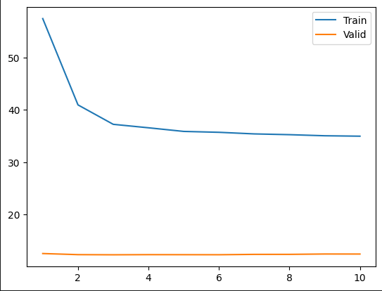
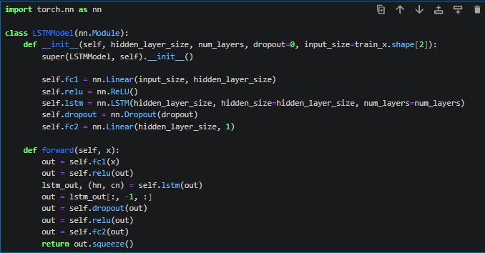
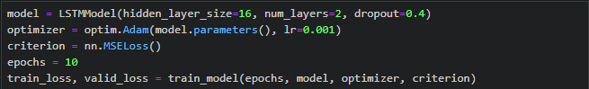
Neural Network
Got weird loss curves so pitcher predictions had worse rmse
Presume something incorrect in data preprocessing but used same method as the hitter data and neither of us could find the issue
RMSE of 5.5

Slide 29
Using the mean as a baseline model
Hitters
Mean RMSE: 7.1021
Linear Model: 7.304 → -2.84%
ME Model: 7.324 → -3.12%
XGBoost: 7.317 → -3.03%
LSTM: 6.9276 → 2.46%
Pitchers
Mean RMSE: 6.7494
Linear Model: 4.213 → 37.58%
XGBoost Model: 4.178 → 38.10%
LSTM: 5.5322 → 18.03%

Slide 30
Final Thoughts
Training on personal machines took a *long* time
Might look more into the erraticness of the points near the end of the season and possibly create distinct models for “end of season”
Figure out what’s wrong with the validation preprocessing on the pitcher dataset
Generate Optimal Lineups and compare to actual performances
We have a framework for running these simulations, however we ran into some last minute problems, which didn’t allow us to get to it

